Slide 1

File Sharing Web Application
Full Stack Project with React, Spring Boot, MongoDB & Tailwind CSS
Anshika
Bhavik Kumar
2310990142
Deewanshi Gujral
2310990152
Devanshi Gupta
2310990153

Slide 2

Project Overview
This project presents a robust, full-stack file sharing web application designed for secure and efficient digital asset management. It allows users to upload, organize, and share files with granular control over access and visibility.
The application emphasizes a seamless user experience while prioritizing security through integrated authentication. It demonstrates proficiency in modern web development practices across frontend, backend, and database layers.

Slide 3

Core Objectives
File Management
Visibility Control
Upload, preview, download, and delete files securely.
Toggle files between public and private access.
Share public files via unique, shareable links.
User Experience
Flexible file viewing in both grid and list modes.
Implement user-based access for personalized content.

Slide 4






Technology Stack
Frontend: React.js
Backend: Spring Boot
Modern JavaScript library for building dynamic user interfaces.
Robust Java-based framework for rapid API development.
Database: MongoDB
Styling: Tailwind CSS
NoSQL database for flexible and scalable data storage.
Utility-first CSS framework for rapid and responsive UI development.
Authentication: Clerk
Integrated user management and authentication solution.

Slide 5
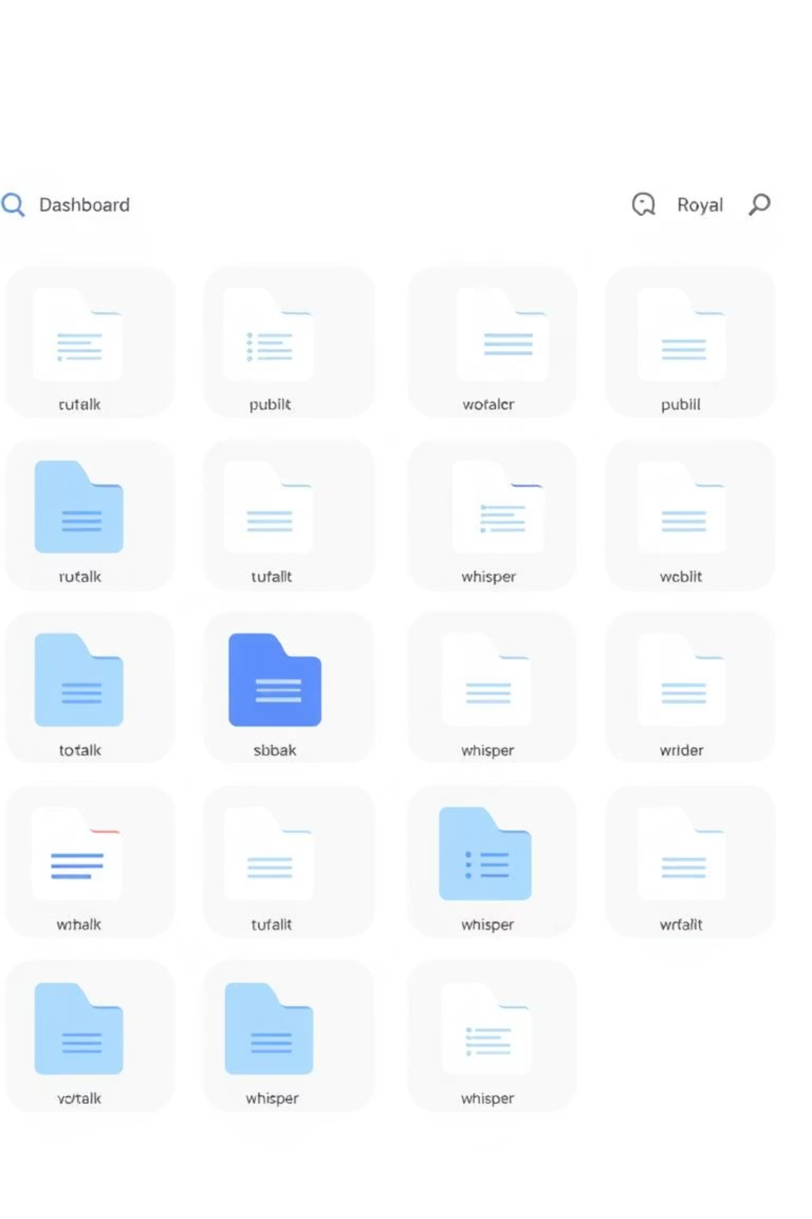
Key Features
Comprehensive File Management: Seamless upload, organization, preview, and deletion of files.
Responsive User Interface: Designed with Tailwind CSS for optimal viewing across devices, utilizing reusable components for consistency.
Dynamic Access Control: Toggle files between public and private visibility, generating unique shareable links for public content.
Secure User Authentication: Integrated Clerk authentication ensures secure user registration, login, and file access control.
Flexible File Views: Intuitive grid and list display options to suit user preferences.

Slide 6





System Architecture
The application follows a standard three-tier architecture, ensuring clear separation of concerns and scalability.
Backend
Authentication
Spring Boot (includes file handling)
Clerk as external auth service
Frontend
Database
React.js with Tailwind CSS
MongoDB for data storage
User authentication is handled externally by Clerk, enhancing security and reducing development overhead. File operations are securely managed by the Spring Boot backend.

Slide 7
Key Components
The application's modular design relies on several key components, each responsible for a specific part of the user experience.
1
2
FileCard & FileListRow
Dashboard
Display individual file details in grid and list views respectively.
The central hub for users to manage and view all their files.
3
4
Navbar & Sidebar
Authentication Flows
Provide consistent navigation and quick access to features.
Managed by Clerk for secure user sign-up, login, and session control.

Slide 8
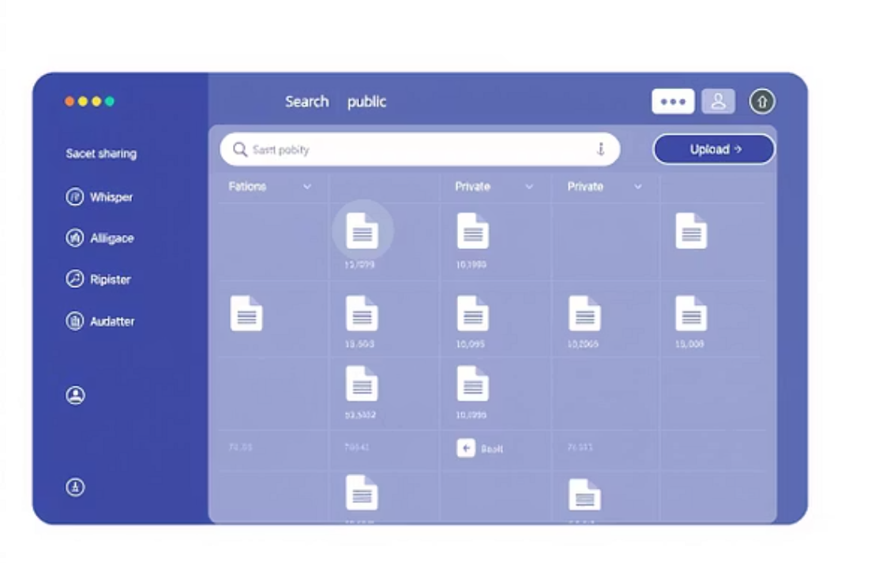
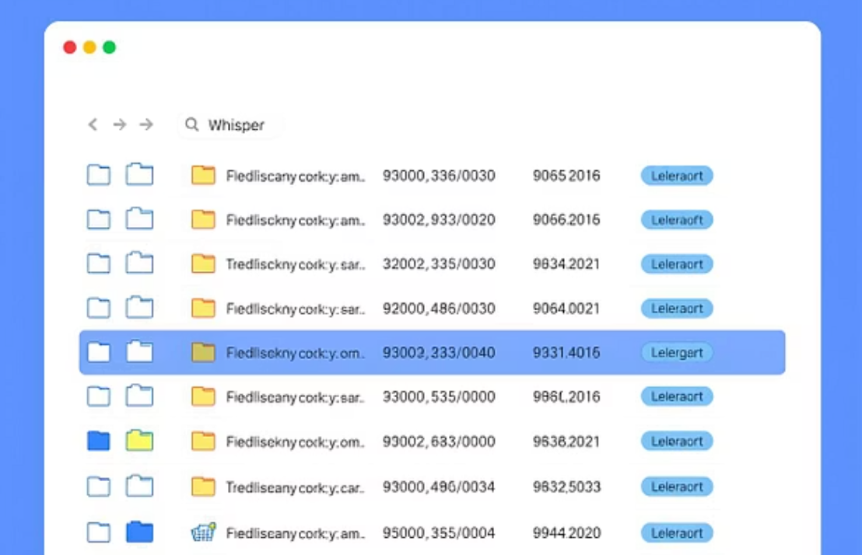
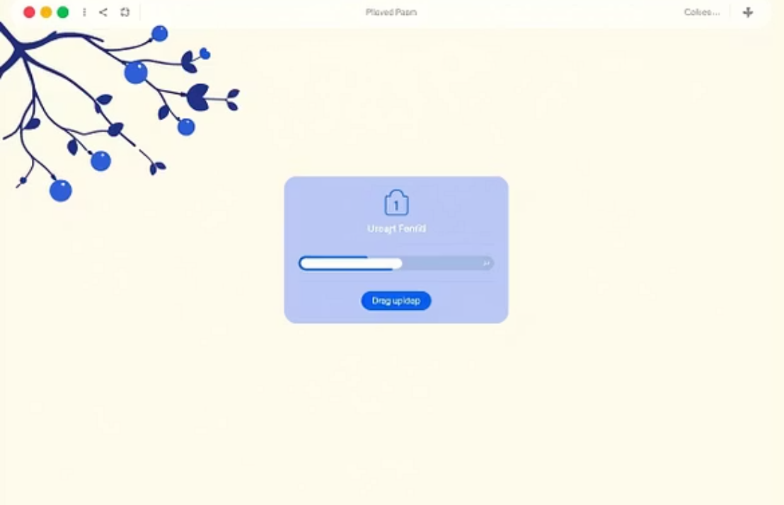
UI Preview
Experience a clean, responsive, and intuitive user interface designed for optimal file management.

Slide 9
Learning Outcomes
01
02
Full-Stack Integration
File Management & ACL
Gained expertise in connecting frontend, backend, and database layers.
Mastered secure file handling and user-based access control logic.
03
04
Responsive UI Development
Modular Code Design
Developed highly responsive interfaces using modern CSS frameworks.
Implemented a clean, reusable, and maintainable component structure.

Slide 10
Conclusion & Future Work
This project successfully delivers a secure and functional file sharing platform, showcasing a strong grasp of full-stack web development.
Summary
Potential Enhancements
The application enables robust file management, flexible sharing, and secure user authentication, built with a modern and efficient tech stack.
Implement subscription tiers or payment integration for premium features.
Add cloud deployment to platforms like AWS, Azure, or Google Cloud.
Introduce file versioning and collaborative editing features.
Integrate advanced search and tagging capabilities.
Thank you!

